Slide 1
Library Management System
LMS
Made by: Zoltán András Tóth, Máté Vágvölgyi, Soma István Zsömbörgi

Slide 2
The problem
The solution
We decided to create our own program to replace the obsolete software with managing books, users and all the borrowings.

Slide 3
The problem
The solution
We heard librarians say they are dissatisfied with the current system.
It was also inconvenient for us, students.
We decided to create our own program to replace the obsolete software with managing books, users and all the borrowings.

Slide 4
The problem
The solution
We heard librarians say they are dissatisfied with the current system.
It was also inconvenient for us, students.
We decided to create our own program to replace the obsolete software with managing books, users and all the borrowings.

Slide 5
The problem
The solution
We heard librarians say they are dissatisfied with the current system.
It was also inconvenient for us, students.
Teamwork
We decided to create our own program to replace the obsolete software with managing books, users and all the borrowings.

Slide 6







Teamwork
Allocation of tasks:
Frontend: Zoltán Tóth
Backend: Soma Zsömbörgi
Desktop Application: Máté Vágvölgyi
Database: Soma Zsömbörgi, Máté Vágvölgyi
Applications:
GitHub
Discord
Figma

Slide 7
Base idea

Slide 8
Base idea
Frontend
Backend
Website for members
Register to reserve
Verify email address
Connection between Frontend and Database

Slide 9
Base idea
Frontend
Backend
LMS Desktop
Website for members
Register to reserve
Verify email address
Connection between Frontend and Database
Software for admins and librarians
Application for managing a physical library

Slide 10
Base idea
Frontend
Backend
LMS Desktop
Website for members
Register to reserve
Verify email address
Connection between Frontend and Database
Software for admins and librarians
Application for managing a physical library

Slide 11
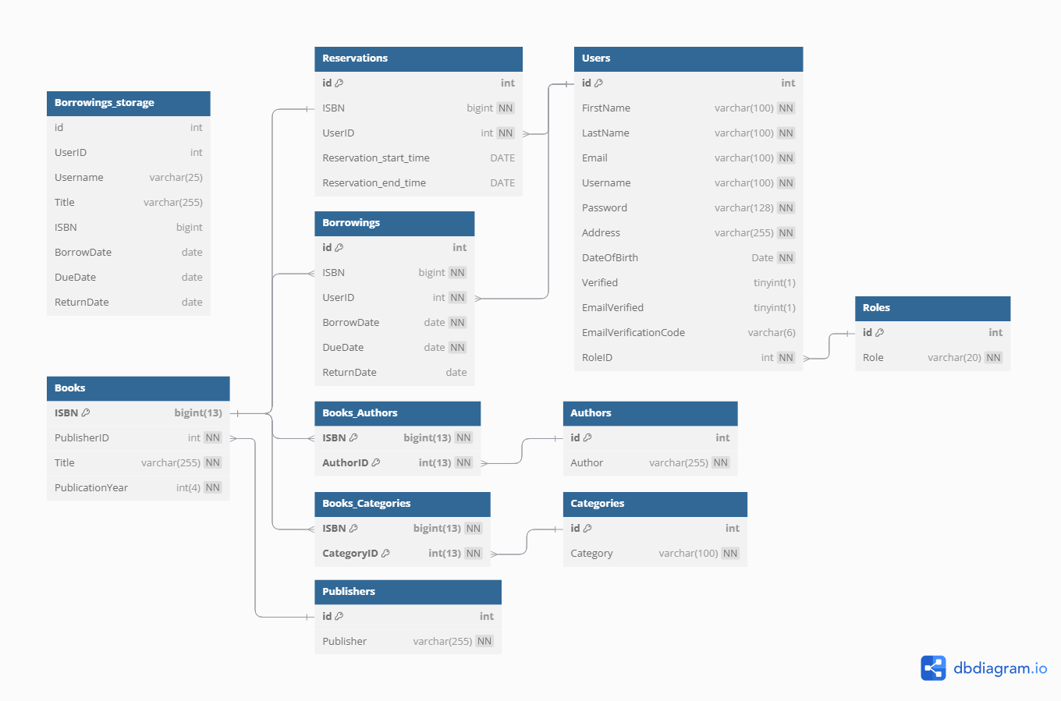
Database

Slide 12
Database
- MySQL
Tables:
11 tables
2 bridging table
1 long term storage table
Cascade on deletion
Triggers:
Delete books if bridging tables are deleted
Copy and update borrowings
Events:
Delete expired reservations

Slide 13
Database - MySQL
Tables:
11 tables
2 bridging table
1 long term storage table
Cascade on deletion
Triggers:
Delete books if bridging tables are deleted
Copy and update borrowings
Events:
Delete expired reservations

Slide 14
Frontend

Slide 15
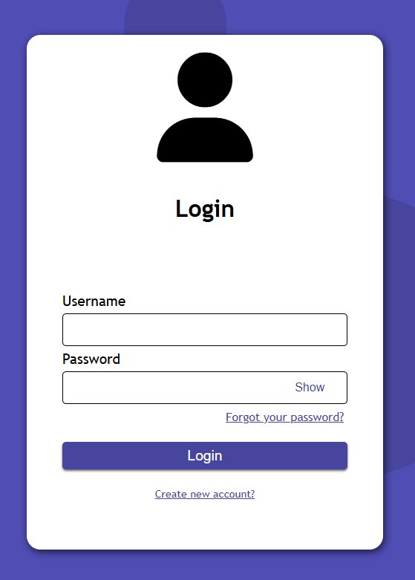
Functions of the Website -
Frontend
Login
Register
Finalize registration
Verification
Search in available books
User’s reservations
User’s borrowings

Slide 16
Functions of the Website -
Frontend
JWT Webtoken for authorization
Store token in session storage
Forgot password option
Get method with Axios

Slide 17
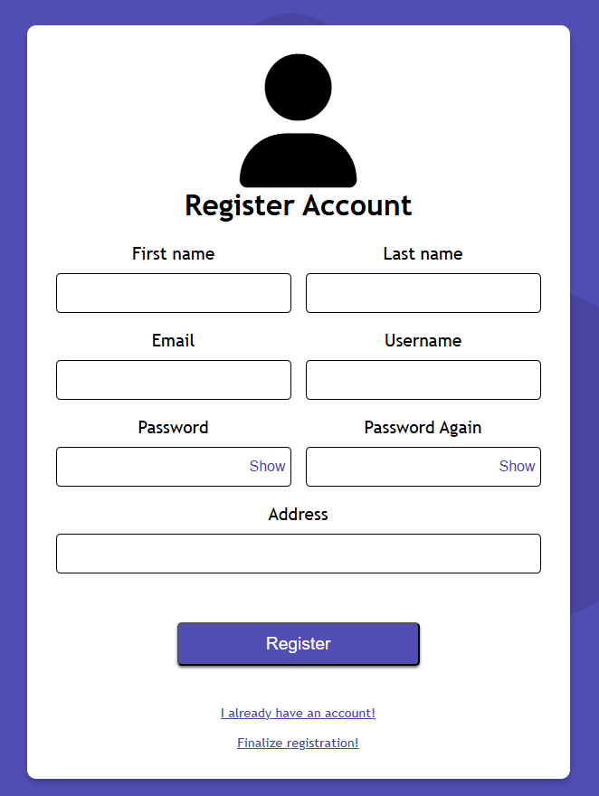
Functions of the Website -
Frontend
Post method using Axios
Finalize registration option
If a librarian added the user, they can finalize their registration
Verification

Slide 18
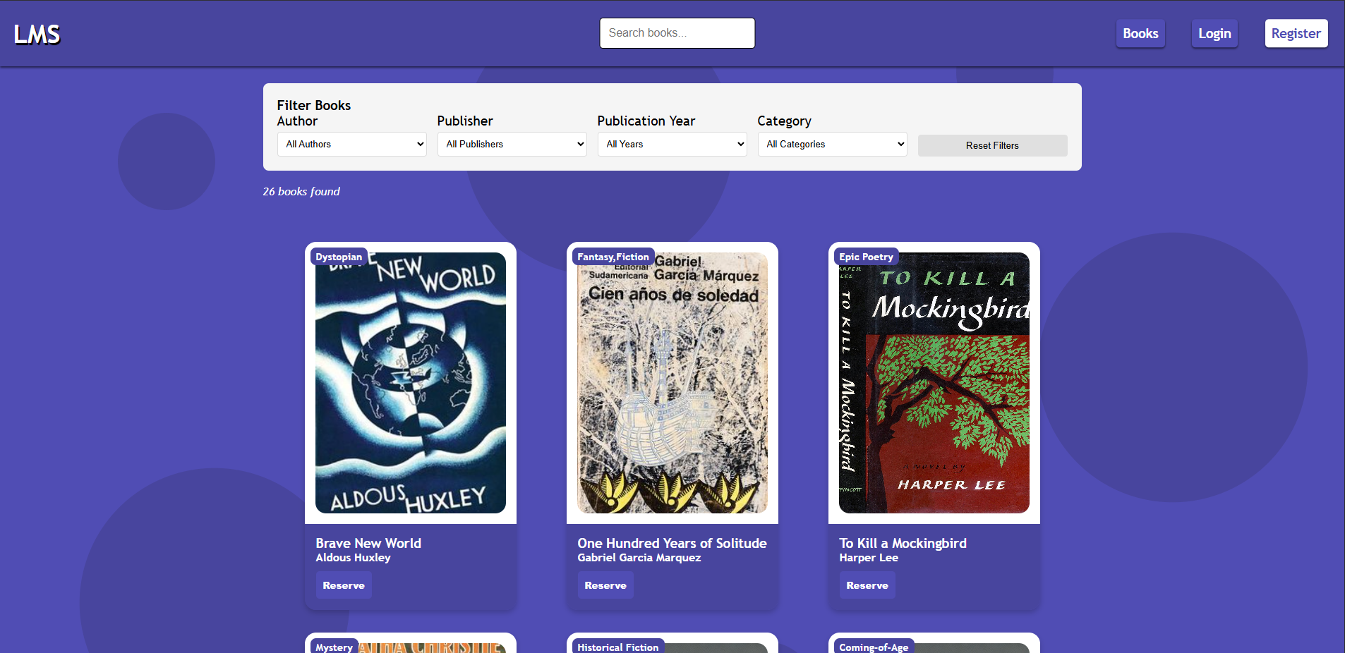
Functions of the Website -
Frontend

Slide 19
Functions of the Website -
Frontend
Live search
Filter books
Author
Publisher
Publication year
Category
Reserve books if logged in

Slide 20
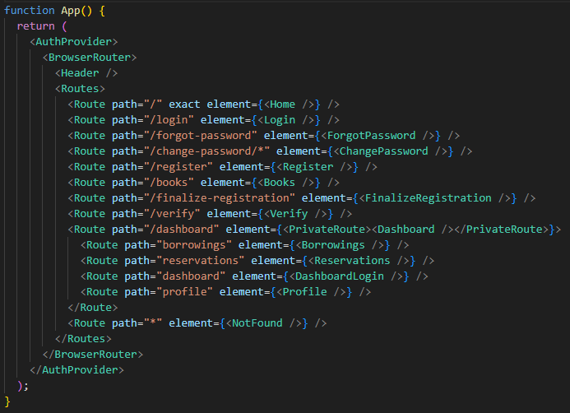
What did we use?
React Router
useState
useEffect
useLocation
useNavigate
createContext
useRef
useMemo

Slide 21
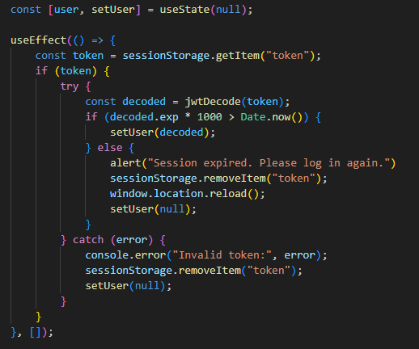

What did we use?
Decoding Token
Auth Provider

Slide 22
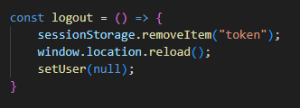
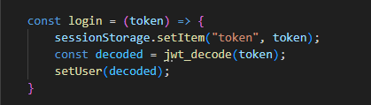
What did we use?
Decoding Token
Managing user activities
Auth Provider

Slide 23
What did we use?
Decoding Token
Managing user activities
Auth Provider
Backend

Slide 24
What did we use?
Decoding Token
Managing user activities
Backend
Connect database with frontend
Manages data from website
CRUD operations:
GET
POST
PUT
DELETE
Responses:
JSON
Image

Slide 25
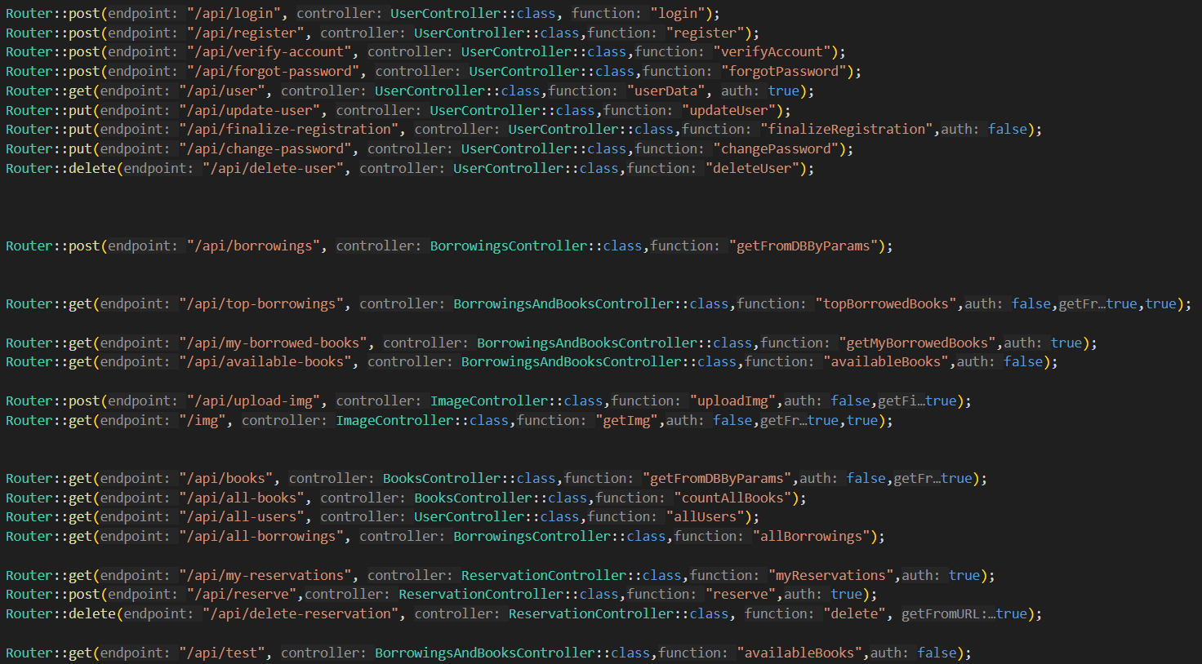
Functions of the Website -
Backend
Connect database with frontend
Manages data from website
CRUD operations:
GET
POST
PUT
DELETE
Responses:
JSON
Image

Slide 26
Connect database with frontend
Manages data from website
CRUD operations:
GET
POST
PUT
DELETE
Responses:
JSON
Image

Slide 27
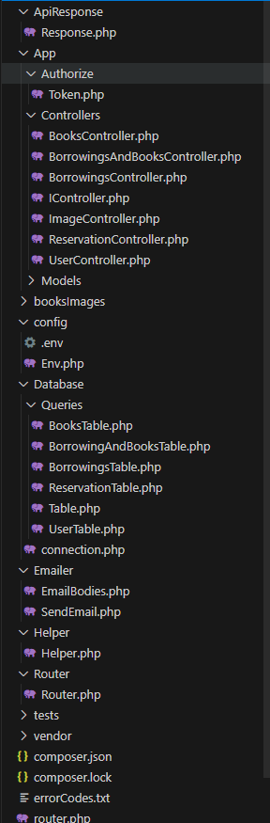
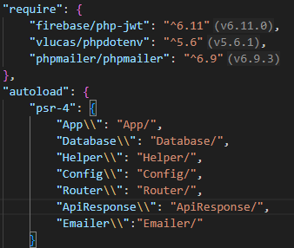
What did we use?
Composer
JWT
Dotenv
PHPMailer
Autoloader

Slide 28
MVC –
Model
-View-Controller

Slide 29
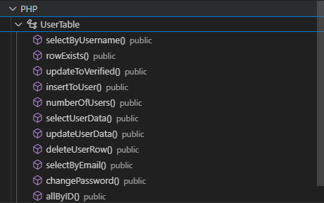
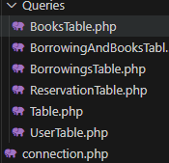
Model
s
MySQL queries in models
Select, Insert, Update, Delete
Models inherit from tables:
Select
Join
Execute

Slide 30
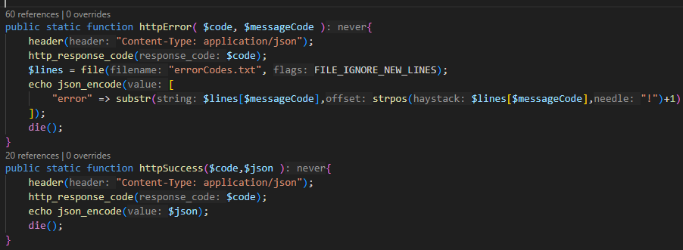
Views - Responses
Success:
Returns status code
Returns JSON as string
Error:
Messages stored in txt file
Returns status code
Returns error message from txt file

Slide 31


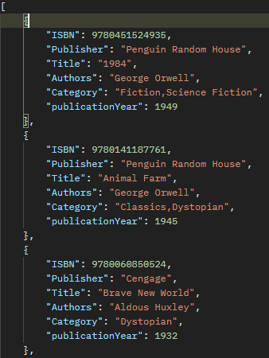
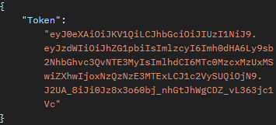
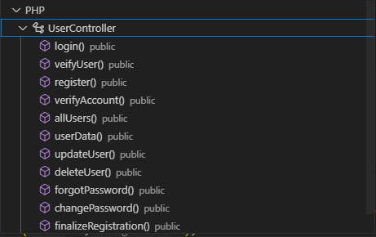

Controllers
Handle request body
Parameters as associative arrays
Verify values by controllers
The functions themselves are in separate classes

Slide 32
LMS Desktop

Slide 33
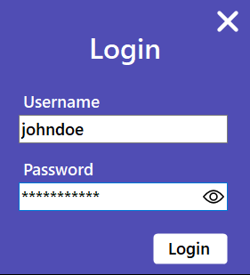
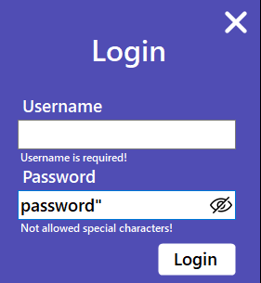
Functions of
LMS Desktop
Login
Admin or Librarian
Show password
Real time error feedback

Slide 34
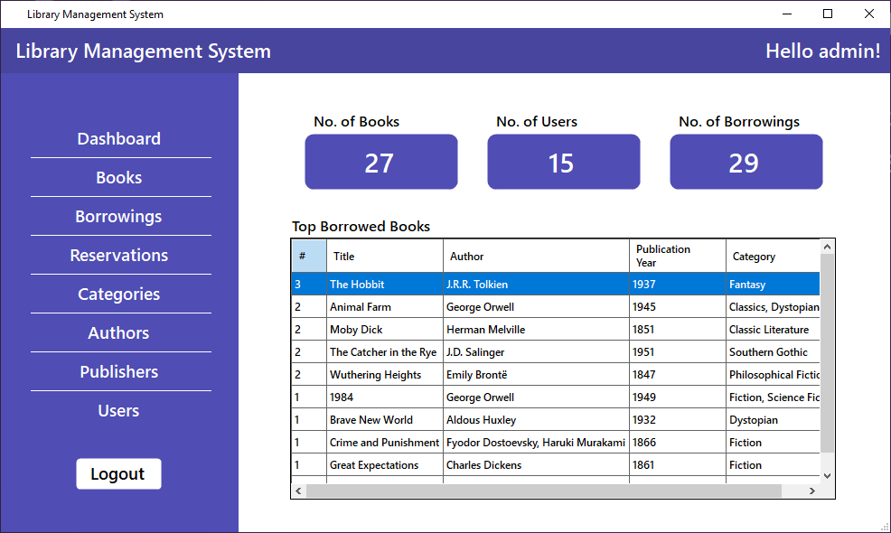
Functions of
LMS Desktop
Login
Admin or Librarian
Books, user and borrowing statistics
Manage database through the app
Change personal data
Show password
Real time error feedback

Slide 35
Functions of
LMS Desktop
Books, user and borrowing statistics
Manage database through the app
Change personal data

Slide 36
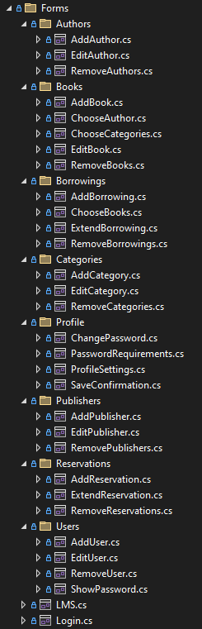
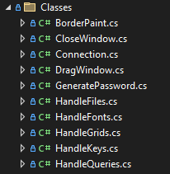
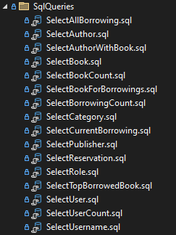
What did we use?
Windows Forms – C#
.NET 8.0
Nugget Packages:
MySQL
BCrypt
HTTP Client
Regular Expressions
OnceClick
Inno Setup Compiler

Slide 37
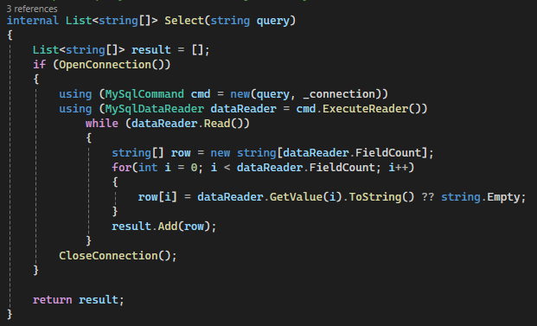
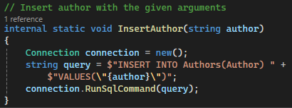
MySQL connection in C#
Reusable Select function
Straightforward function names

Slide 38
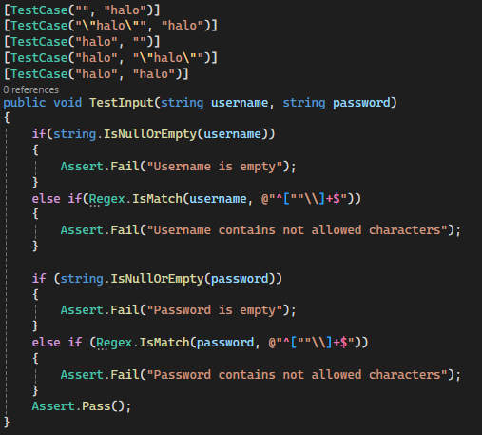
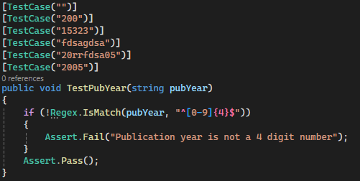
NUnit testing
Testing Login page
Testing publication year with regular expressions

Slide 39
Future improvements
Separate mobile application
Overdue fees -> Online payment
Changeable languages
Customizable themes

Slide 40
Sources
Presentation template
All source for the pictures are linked to them

Slide 41
Library Management System
LMS
Made by: Zoltán András Tóth, Máté Vágvölgyi, Soma István Zsömbörgi

